Slide 1
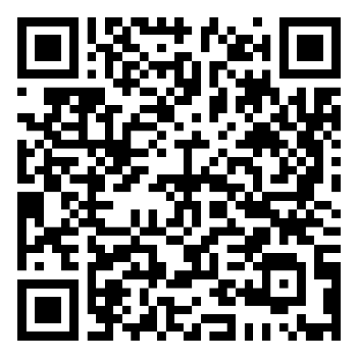
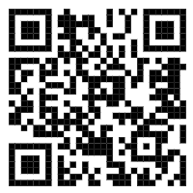
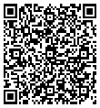
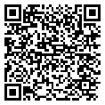
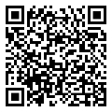
Sustainable waste separation
Hotel's public areas: Please kindly separate your waste. Waste collection bins are equally distributed by type to ensure that wherever there is a general waste bin, there is also a recycling station.
Guest rooms: Please use the room bins only for mixed/general waste and please kindly place your recycling waste to the side of the bins or dispose in the recycling bins located throughout the hotel's public areas.
Welcome to Lemon and Soul Makadi Garden!
We wish you a pleasant stay with us.
MUST-KNOWS FOR YOUR STAY
FOR YOUR CONVENIENCE
Reception
The reception is open 24 hours a day. Our reception team will gladly provide you with information about dining, spa and wellness, activities and/or arrangement related to your stay.
Wi-Fi
Wi-Fi is complimentary and available in the Lobby and on the Terrace. Please log-in using the details below:
Room Number: ****
Last Name: ****
E-Mail address: ****
Check-out
Check-out time is 12:00. If you would like to request for a late check-out, please contact our reception for the availability and applicable charges.
Menus A La Carte Restaurants
Reservation A La Carte Restaurant
STAY IN TOUCH WITH US
Lemon and Soul Makadi Garden lemonandsoulmakadigarden
https://www.lemonandsoul.com/makadi-garden
Bewerten Sie uns bei
Scan to access the full
Guest Directory Service

Slide 2
Main Restaurant “Zesty” *
Early Breakfast from 00:00 till 06:00
Breakfast from 07:00 till 10:00
Lunch from 12:30 till 15:00
Dinner from 18:30 till 21:30
Late Dinner from 21:30 till 00:00
Pool bar “Lime 19”
From 10:00 till 00:00
Coco Bar & Gelateria ($)
From 10:00 till 00:00
Roof Top Bar ($)
From 15:00 till 22:00
Eat&Go (pool)
Late breakfast from 10:00 till 11:00
Snacks from 15:00 till 17:00
Food Truck (beach)
From 12:00 till 15:00
The Point Beach Bar (beach)
From 10:00 till 17:00
Del Mare (beach)($)
Brunch from 08:00 till 11:00
Lunch from 12:00 till 15:00
Dinner from 18:30 till 21:30
Speciality Restaurants (Makadi Promenade)
Once per stay (min. stay 7 nights)
from 18:30 till 21:30 (please make your reservation at the Guest Relations desk from 09:00 till 14:00)
Italian: “La Mamma”
Texas Burger: “Texas Burger”
Indian: “Taj Mahal”
Asian: “Red Dragon”
Greek: “Taverna Syrtaki”
Oriental "cafe Cairo" Sushi Bar “Banzai”
French: “Wine House”
“Tajine”Tunisian, Morrocan & Lebanese
Wrap restaurant: “Shawerma World”
Steak House, Ras El Naga, Sea Treasure ($)
*Restaurants and Bars operating hours may vary depending
on seasonality and weather conditions
Coco Loco Lounge & Disco ($)
From 10:00 till 18:00 beach lounge
From 22:00 till 02:00 am disco
Minibar ($)
Mini Bar against charge مكونات المينى بار بتكلفة إضافية (price is available on top of the minibar) Daily one bottle of water free of charge. Tea & coffee station is being refilled daily free of charge unless the “Do Not Disturb“ sign is hanged on the door
Beach towels
In case of lost beach towels or towel cards, a fee of 15 Euro will be charged.
Changing beach towels at the Beach from 07:00 until Sunset
It is not allowed to hang clothes or towels on the Balcony.
Fitness & Wellness
Spa “La Brise” from 10:00 - 19:00
Sauna, Steam room, Massage treatment ($)
Fitness Room at Labranda Royal Makadi ($)
Squash, tennis at Labranda Royal Makadi ($)
Dress Code & Restaurant rules
Dinner Men are required to wear trousers, decent shirts
or polo’s & closed shoes.
Women are required to wear dinner dress or equivalent attire.
Breakfast & Lunch
Shorts, sandals and beach/swimming wear are allowed if worn with appropriate tops or light summer dress.
Management will always advise guests of the dress code regulations when needed and expect cooperation in order to maintain the standards of quality in the property.
Swimming Pool Dress Code
Proper swimming wear is required; for your health and hygiene. It is prohibited to wear full body swimming dresses & cotton T-shirts
RESORT REFERENCE GUIDE
Makadi-Hurghada-Red Sea– Egypt
P.O. Box 341
Tel: (+20) 65 3590 555-58
Fax: (+20) 65 3590 563
E-mail: guestrelation.lemonandsoul@mphotelseg.com
Website: www.labranda.com
GENERAL INFORMATIONS
For Reception dial 3 For Guest Relations dial 1107
For Room call 4 (and Room
Whatsapp +20 103 201 7976
CHECK IN: 15:00PM CHECK OUT: 12:00NOON
Guest Relations
Guest Relations desk is located next to the reception desk
Safety Deposit Boxes
Safety deposit boxes are provided without charge in the rooms. The hotel management takes no responsibility for any valuables left in guest rooms.
Hotel Doctor
The hotel doctor is 24h a day available for emergency
cases through the reception desk.
Internet
WI-FI internet is for free in the Lobby and on the Terrace

