Slide 1
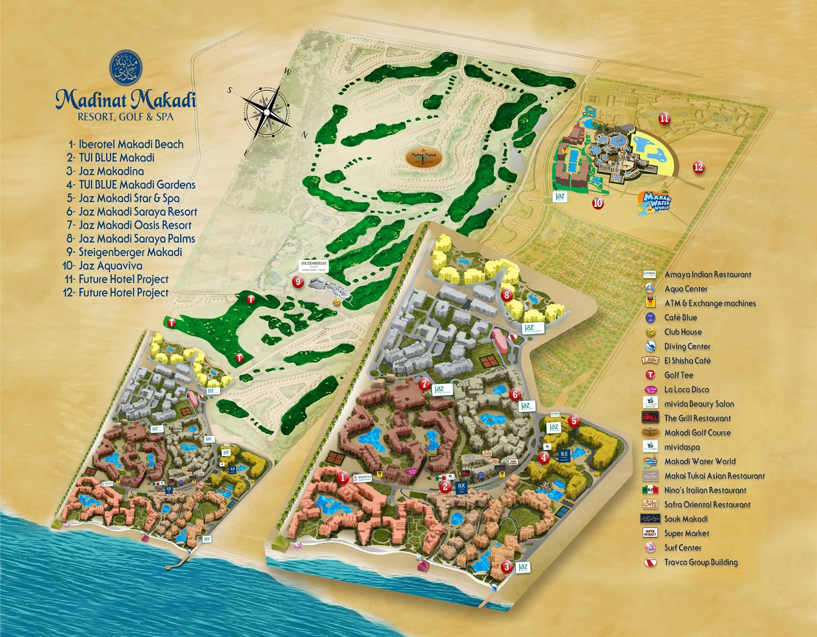
LIVE THE MAKADI MINDSET!
Jaz Makadi Saraya Palms
Hotel Info - English
www.jazhotels.com 19380

Slide 2
ROOM & KEY CARD
﻿﻿Tea and coffee making facilities are replenished daily
﻿﻿1.5L bottle of water per room on daily basis
﻿﻿Minibar: Please notice the minibar list in your room
SAFE
We kindly ask that all valuables are placed in the safe inside the wardrobe, as the hotel cannot accept any responsibility for the loss of these. Please leave the safe open on departure day.
TELEPHONE
Please contact reception by dialing 0. Available 24/7.
To make national or international calls, please contact our reception. To call another room, please dial the respective room number.
RECEPTION
Our 24 hour service will assist with all general questions, and provide relevant information such as directions, limo reservations, bedding, porter service etc.
Check-in 14:00 pm, check-out 12.00 pm.
Late check-out is subject to availability and with extra charge.
INTERNET
Please activate your Wi-Fi and choose JHG network - enter your room number, first name and your email address in the appropriate fields.
Remember to turn off data roaming to avoid network charges from your operator.
POOL & BEACH AREA
You will find pool/beach towels inside your room, changed upon request during your daily turndown service, please leave the towels on the bathroom floor if you require a change. Outside of this time please ring reception.
The reservation of sunbeds is not permitted, and staff is authorized to remove items from sun loungers after extended periods of non-occupancy.
LAUNDRY & DRY CLEANING
There is a laundry bag in the wardrobe.
Please fill out the laundry list with your items and the prices can be found in the laundry list

Slide 3
RESTAURANTS & BARS
Shams Main Restaurant
Breakfast 07:00-10:00
Lunch 12:30-14:30
Dinner 18:30-21:00
Al Gezira Snacks Bar
Late Breakfast 10:30-11:30
Snacks 14:30-17:00
Tea Time 17:00-18:00
Beach Bar
Drinks Service 10:00-Sunset
Snacks 12:00-15:30
Coco Pool Bar
Drinks Service 10:00-Sunset
Manzar Lounge Bar
Drinks Service 18:00-00:00
Dress Code:
For dinner gentlemen are required to wear casual long trousers or smart shorts, ladies to dress modestly.
A LA CARTE RESTAURANTS
1 complimentary dinner per stay in one of the following a la carte restaurants: Nino's, Amaya, Makai Tukai, Sofa, Beach Restaurant, The Grill or Aqua Restaurant.
Restaurants are located within the heart of Madinat Makadi.
Pervious booking is required 48 hours before with the front office team.
Allergies and dietary requirements - please notify Guest Relation Manager.
ENVIRONMENTAL AWARENESS
We are extremely concerned of our environment and as such make great efforts to support in all spheres wherever possible.
For more information please refer to our environmental boards and TV information channel No. 1.

Slide 4
SERVICES
Free of Charge
﻿﻿Upon request 1 day in advance book via reception:
﻿﻿Wake up call
﻿﻿Lunch/Breakfast box
﻿﻿Tennis court (Floodlight 100 le/h) In Iberotel Makadi Beach
﻿﻿Billiard in Manzar lounge bar 13:00-24:00
﻿﻿Makadi Water World Aqua park
﻿﻿ATMs are located in Souk Makadi, beside La Loca and in Jaz Aquaviva hotel
Sports & Entertainment
﻿﻿Various davtime activities 10:30-12:30 and 15:00-17:00
﻿﻿Daily evening show acts and live performances Please refer to info boards for a full breakdown.
Jazy Kids Club
Our Jazy Kids Club open 10:00-12:30 and 15:00-16:30 for children from 4 to 12 y.o. Kids Disco at 20:30 in the Lobby Terrace of Manzar Lounge bar.
Extra Charge
﻿﻿Minibar: Please notice the minibar list in your room
﻿﻿Limousine service
﻿﻿El Shisha Bar located in Jaz Makadi Sarava Resort
﻿﻿Fitness room 08:00-19:00 in Jaz Makadi Oasis
﻿﻿Doctor and Pharmacy
﻿﻿Mividaspa
﻿﻿Diving center, surf center and water sports
﻿﻿Golf course "A superb 18 hole championship golf course, a fun 9 hole par 3 course, plus excellent training facilities"
TAKE CARE
﻿﻿Avoid direct sunlight especially between 11:00-15:00. Temperatures can reach 45+, which might cause burns and severe dehydration.
﻿﻿Drink water continuously throughout the day. Water is provided in all hotel bars. Dehydration causes upset stomach, dizziness, nausea and headaches.
﻿﻿Always use sunscreen with sunblock to avoid sunburns. Wear a headgear when explored to the sun.

Slide 5
﻿﻿Avoid sudden changes in temperature (from warm to cold and vice versa). Give your body a few minutes to get used to the new temperature. Sudden temperature changes can cause health issues, please do not make your air conditioning in the room colder than 25 degrees.
﻿﻿Please note that due to fire regulations, smoking of hookahs / shisha in the room is not allowed.
﻿﻿The use of third-party providers outside the hotel (e.g. shops, limousines, etc. ) is at your own responsibility.

