Slide 1
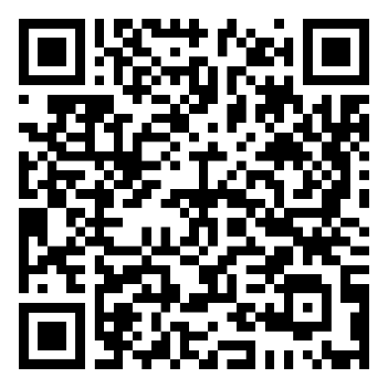
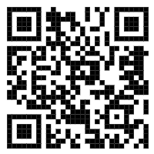
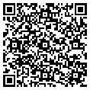
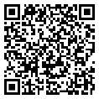
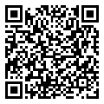
Sustainable waste separation
Hotel's public areas: Please kindly separate your waste. Waste collection bins are equally distributed by type to ensure that wherever there is a general waste bin, there is also a recycling station.
Guest rooms: Please use the room bins only for mixed/general waste and please kindly place your recycling waste to the side of the bins or dispose in the recycling bins located throughout the hotel's public areas.
Welcome to Labranda Royal Makadi!
We wish you a pleasant stay with us.
MUST-KNOWS FOR YOUR STAY
FOR YOUR CONVENIENCE
Reception
The reception is open 24 hours a day. Our reception team will gladly provide you with information about dining, spa and wellness, activities and/or arrangement related to your stay.
To call reception, please dial 3.
Wi-Fi
Wi-Fi is complimentary and available in the Lobby and on the Terrace. Please log-in using the details below:
Room Number: ****
Last Name: ****
E-Mail address: ****
Check-out
Check-out time is 12:00. If you would like to request for a late check-out, please contact our reception for the availability and applicable charges.
Menus A La Carte Restaurants
Reservation A La Carte Restaurant
STAY IN TOUCH WITH US
Labranda Royal Makadi labrandaroyalmakadi
https://www.labranda.com/royal-makadi
Bewerten Sie uns bei
Scan to access the full
Guest Directory Service

Slide 2
Lobby Bar “Golden Sun”
Soft, Hot & Alcoholic beverages
from 10:00 till 00:00 (all inclusive)
Pastry from 11:00 till 22:00
Beach Restaurant “Sunset” *
Breakfast from 07:00 till 10:00
Lunch from 12:30 till 15:00
Main Restaurant “Royal” *
Dinner from 18:30 till 21:30
Oriental Tent “Om Ziad”
11:00 till 16:00 oriental pie
Tea & Coffee from 18:00 till 22:00
18:00 till 22:00 Shisha (extra charge)
“Fritekot” (French Fries & Hot Dog)
11:00 till 12:30
Eat & Go (Burger, Shawerma, etc.)
15:00 - 17:00
*Restaurants and Bars operating hours may vary depending on seasonality, hotel occupancy, weather conditions &
theme nights
Speciality Restaurants (Promenade)
from 18:30 till 21:30 (please make your reservation at the Guest Relations desk from
09:00 till 14:00)
Italian: “La Mamma”
Burger: “Texas Burger”
Indian: “Taj Mahal”
Asian: “Red Dragon”
Greek: “Taverna Syrtaki
Oriental: “Café Cairo” and tea/coffee & shisha(shisha for extra charge)from 15:00 till 22:00
Sushi “Banzai”
Shawerma world
French: “Wine House”
“Tajine”Arabic (breakfast & dinner):
Del mare &Coco Loco & Coral Beach & Steak House & Ras El Naga(extra charge)
from 18:30 till 21:30 (reservation required) Ice Cream Gelateria (extra charge)from 15:00 till 22:00 Wine House:
Late Breakfast: 10:00 till 11:00
Late dinner 21:30 till 00:00
Continental Breakfast from 00:00 till 06:00
for early check out and late arrivals
Late lunch from 16:00 till 18:00 ( for late arrivals only)
Beach Bar “Sunrise”
Beverages from 10:00 till 17:00 Pool bar “Tropicana” + “Rock Pool”
Beverages from 10:00 till 17:00
El Clasico (Sportsbar)
From 10:00 – 00:00
From 14:00 – 00:00 (Bar)
Coffee Bean Bar
Hot, Iced & Hot Coffees with milk from 08:00 till 12:00
Terrace bar
Beverages from 17:00 till 23:00
Coco Loco Lounge & Disco
(Extra Charge)
from 10:00 till 18:00 beach lounge
from 22:00 till 2:00 am disco
Minibar (Package Extra Charge)
Mini Bar against charge مكونات المينى بار بتكلفة إضافية (price is available on top of the minibar) Daily one bottle of water free of charge. Tea & coffee station is
being refilled daily free of charge unless the “Do Not Disturb“ sign is hanged on the door.
Beach towels
In case of lost beach towels or towel cards, a fee of 15 Euro will be charged.
Changing beach towels at the Beach from 07:00 until Sunset
It is not allowed to hang clothes or towels on the Balcony.
Gym & Health Club
Gym & Health Club are opened from 07:00 till 19:00
located on the beach.
Dress Code & Restaurant rules
Dinner Men are required to wear trousers, decent shirts
or polo’s & closed shoes.
Women are required to wear dinner dress or equivalent attire.
Breakfast & Lunch
Shorts, sandals and beach/swimming wear are allowed if worn
with appropriate tops or light summer dress.
Management will always advise guests of the dress code
regulations when needed and expect cooperation in order
to maintain the standards of quality in the property.
Swimming Pool Dress Code
Proper swimming wear is required; for your health and hygiene.
It is prohibited to wear full body
swimming dresses & T-shirts
RESORT REFERENCE GUIDE
Makadi-Hurghada-Red Sea– Egypt
P.O. Box 341
Tel: (+20) 65 359 03 06-13
www.labranda.com
guestrelation.royal@mphotelseg.com
GENERAL INFORMATIONS
For Reception dial 3 Or 0
For Guest Relations dial 5115
For Outside line dial 9
Room service (extra charge) 5402 Whats-app / Telegram +2 01030996497
CHECK IN: 15:00 CHECK OUT: 12:00 NOON
Guest Relations
Guest Relations desk is located next to the reception desk
Safety Deposit Boxes
Safety deposit boxes are provided without charge in the rooms. The hotel management takes no responsibility for any valuables left in guest rooms.
Hotel Doctor
The hotel doctor is 24h a day available for emergency cases through the reception desk.
Internet
WIFI internet is for free in the Lobby and on the Terrace
All inclusive concept
10:00 till 00:00

